Slide 1
Foundations of
World Sustainability
Professor Wayne Hayes
October 26, 2011
V. 0.5 | Build #6

Slide 2
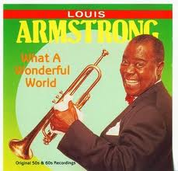
Mood music:
What a wonderful world!
Louis Armstrong sings so.

Slide 3
Agenda
October 26, 2011
Overview, business, announcements
Introductions: Who are we and why are we here?
What does sustainability mean? Discussion
Foundations of Sustainability: The Brundtland Commission Report: origins and legacy
Break
Resume Brundtland
Wolfgang Sachs, Fairness in a Fragile World
Next class: Introduction to the Economics of Sustainability
Notes:
Preview

Slide 4
My goals here today are to
Get to know you.
Introduce world sustainability.
Transition to Economics of Sustainability

Slide 5
Introductions
Introductions from class:
  Who I am
  Why I am here
  My aspirations and goals
Introduction by Professor Hayes
History and design of MASS
My concerns

Slide 6
I keep in mind the
SUDS acronym.
Substance: Form and content
Urgency: pressing necessity
Depth: profound, foundational thought
Strategic: effective conduct; savvy, shrewd

Slide 7
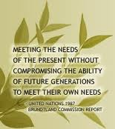
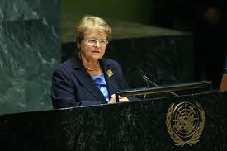
Gro Harlem Brundtland’s
Message
Notes:
From extensive web site, not a mess

Slide 8

The Brundtland Commission
Report
The World Commission on Environment and Development,
Our Common Future, 1987

Slide 9
Foundations of Sustainability:
Web Resources
Professor Hayes’s web page for our classes together
The Brundtland Report online
The Executive Summary of the Report
The definition of sustainability from the report

Slide 10
Background to the
Brundtland Commission Report
See my summary wiki page on Brundtland.
Examine my Prelude to Brundtland.
The reception by the Reagan administration was chilly. The report clearly responded to Prime Minister Thatcher’s TINA: There was an alternative.

Slide 11
Significant aspects of the message
The report’s 21 commissioners approved the final version unanimously.
The report boldly contradicted the reigning paradigm of economic globalization.
The report redefined development, transcending the imperative of economic growth.
The report explicitly welcomed NGOs, defining a role for civil society.

Slide 12
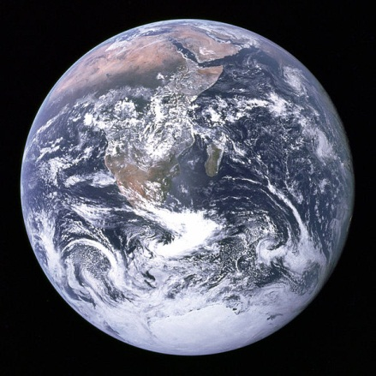
Why is the report important?

Slide 13
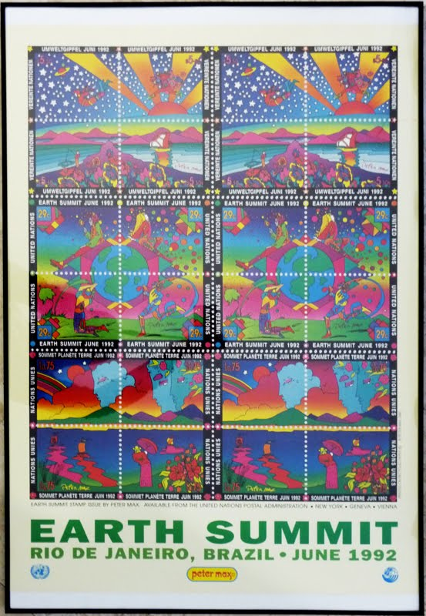
The Brundtland Report set the stage for the Earth Summit in Rio in 1992.

Slide 14
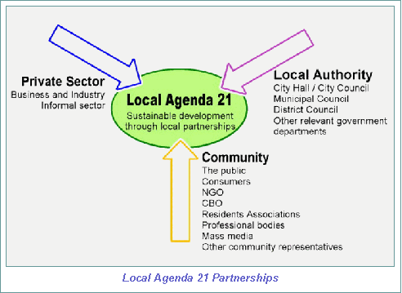
The Earth Summit created
Agenda 21 to guide local implementation.

Slide 15
The scope and breadth of the report is still daunting.
The geographical scope is planet-wide.
The cultural worlds include all peoples, not just U.N. member states. Note the title of the overview, Our Common Future, From One Earth to One World.
The time span is reckoned among generations.

Slide 16
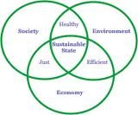
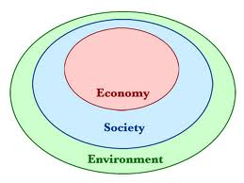
The triple bottom line was made explicit.
See my wiki page for a discussion.

Slide 17
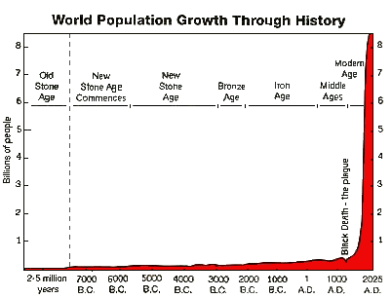
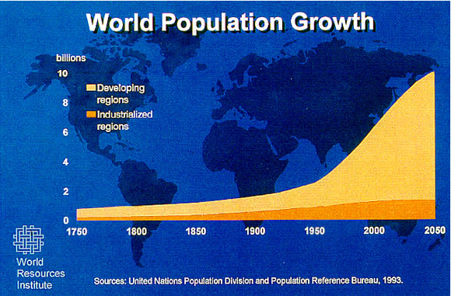
Global population now poised to reach seven billion on Halloween, 2011.

Slide 18
The human ecological footprint exceeds Earth’s carrying capacity.
The ecological footprint is the amount of biologically productive land and water needed to produce the goods and the consume the waste to support each of us.

Slide 19
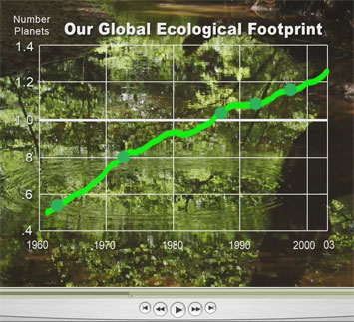
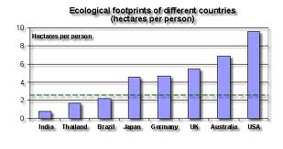
The human ecological footprint steadily grows, unevenly.
2008 data

Slide 20
Wolfgang Sachs:
Fairness in a Fragile World
Who is Wolfgang Sachs?
What prompted the report?
Why the format: a memorandum?
View the short version of the report or the long version.

Slide 21
Main points of
Fairness in a Fragile World
A global deal was desperately needed. Still is. Sachs, active in civil society at U.N., is setting an agenda to broker that deal.
Johannesburg summit (WSSD) would revert to a growth model based on trans-national corporations and privatization.
Copycat development was impossible: only one earth.

Slide 22
Main points of
Fairness in a Fragile World
Sachs contrasts livelihood rights vs. export-led growth --- an inversion of the Washington Consensus.
Land, water, energy, culture: Sachs lays out a concept plan for sustainable development.
Note the significance of women throughout the memo.

Slide 23
The proposed deal: the 3 Rs
Restraint on the part of the rich countries.
Protection of livelihood rights.
Restoration of nature and culture.

Slide 24
Statement of Concern
Read my online statement for class discussion. The stakes are high, the trends disturbing, crises intersect --- or soon will.
What do you think?
Notes:
Awareness grows,

Slide 25
Next class
Introduction to the Economics of Sustainability. See my Foundations of Sustainability web site.

